Slide 1

States of Fragility 2025
For strong strategies in a competitive geopolitical landscape
Les états de fragilité 2025
Pour des stratégies fortes dans un contexte géopolitique compétitif
S

Slide 2
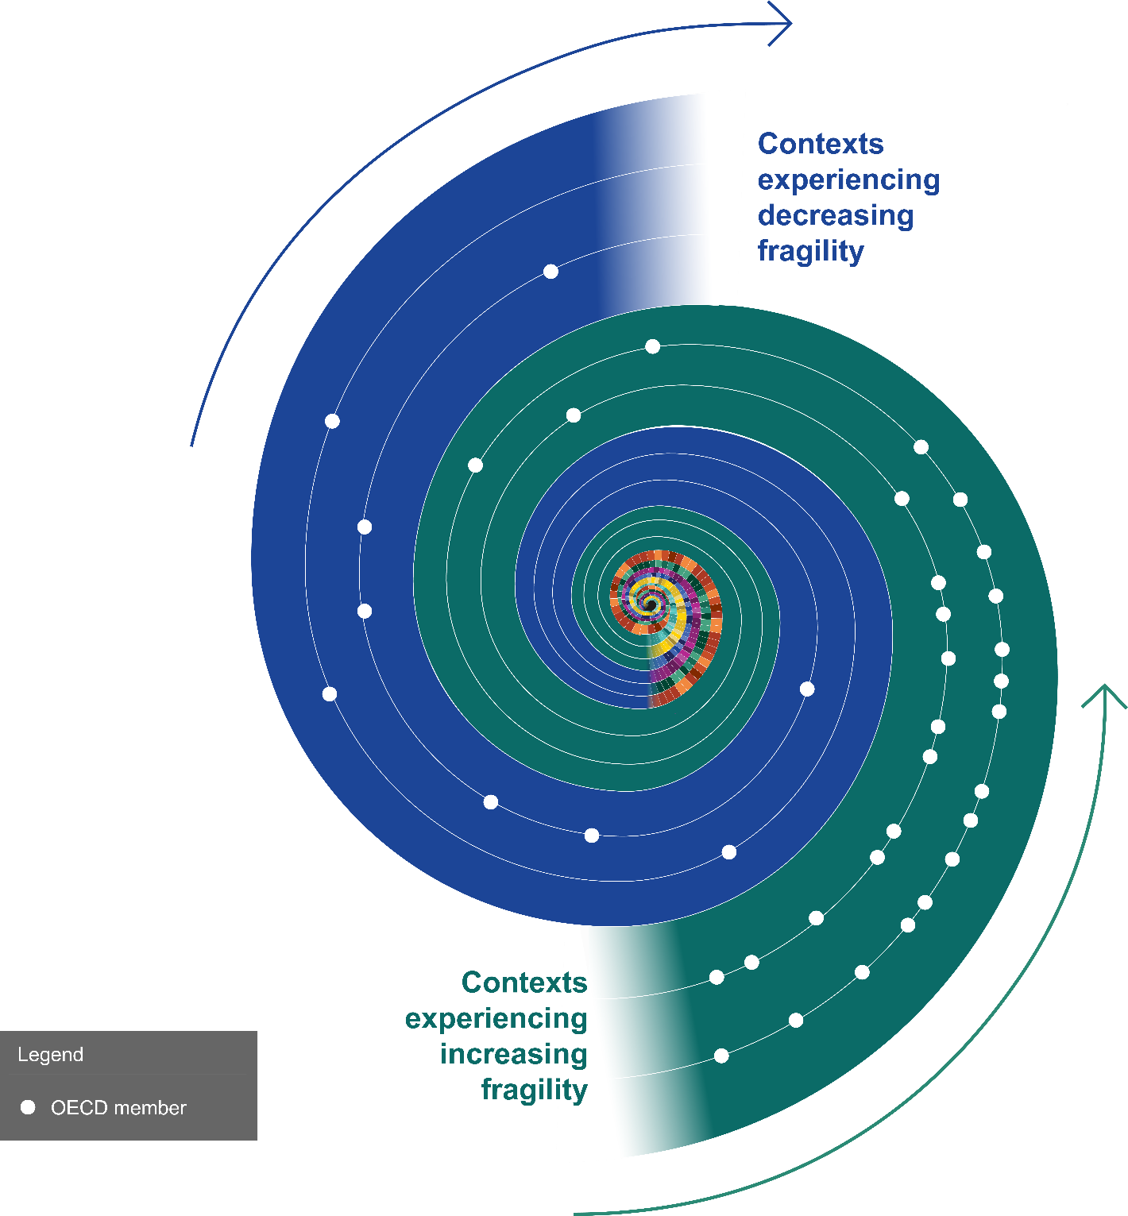
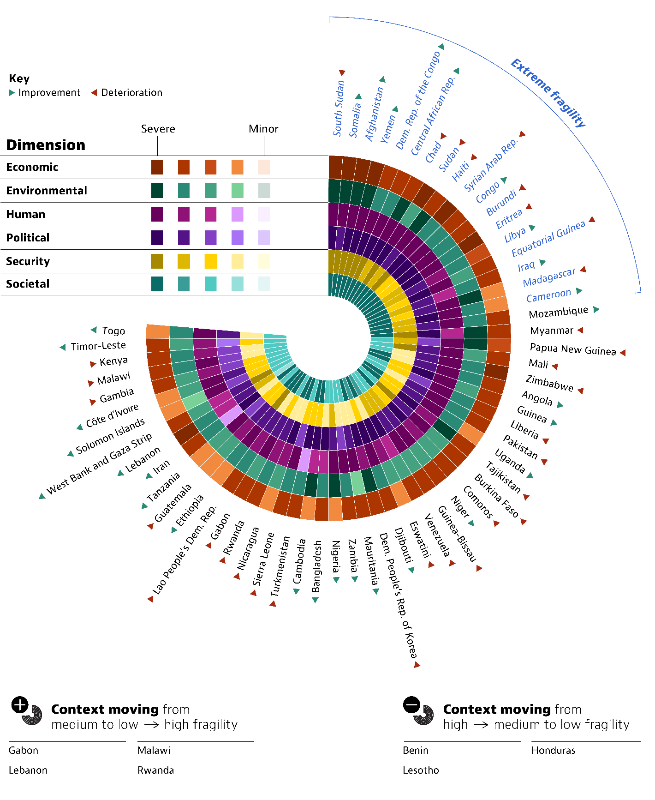
Global exposure to fragility in 2025

Slide 3
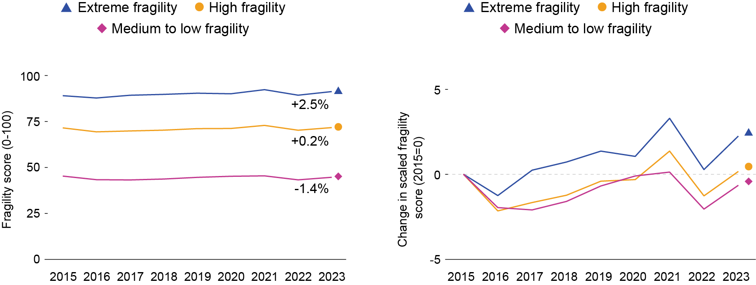
Fragility increased the most in contexts with the highest exposure

Slide 4
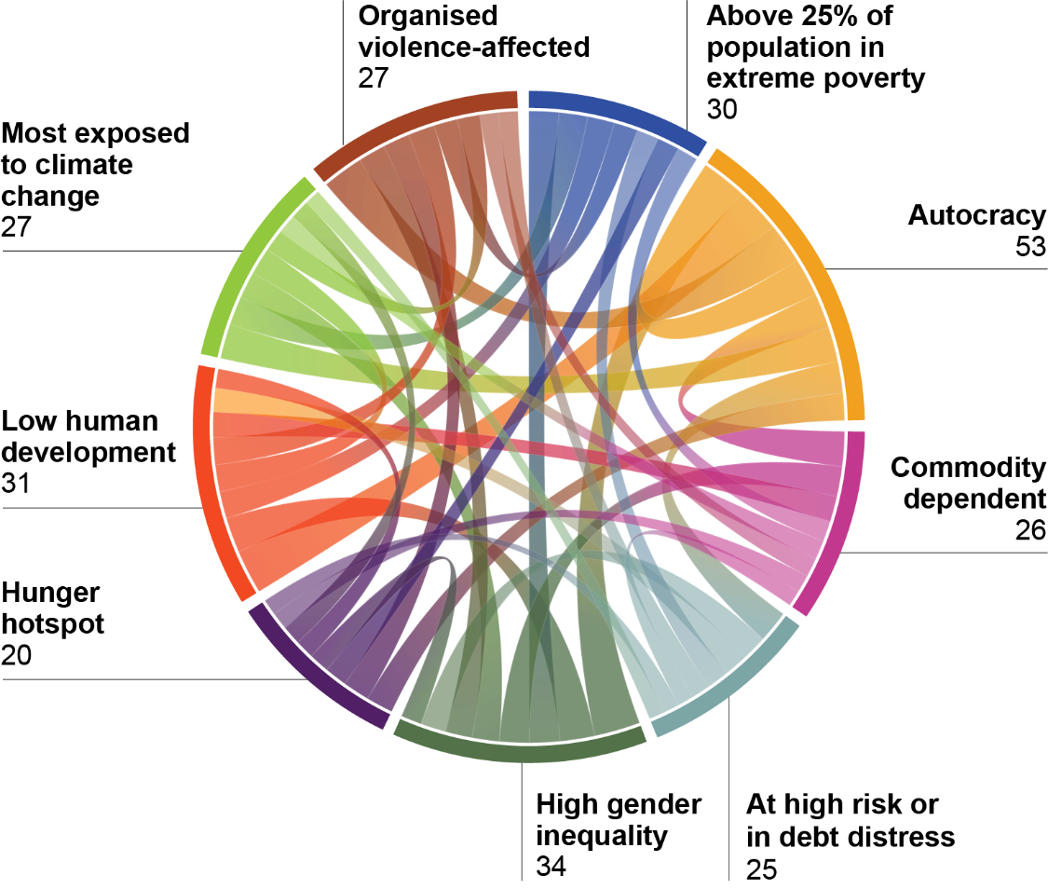
Understanding fragility to build better responses

Slide 5
Peace and development ODA for high and extreme fragility has declined

Slide 6
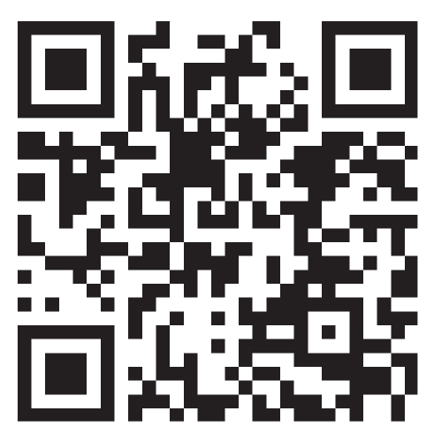
Further resources:
Fragility platform: https://www3.compareyourcountry.org/states-of-fragility/overview/0/
States of Fragility 2025
(English and French)

Slide 7
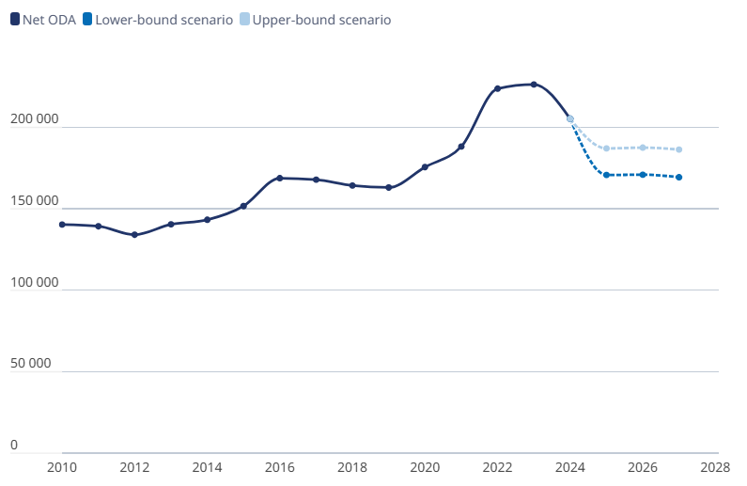
ODA – future outlook up to 2027

