Slide 1

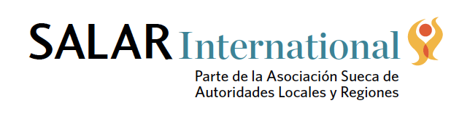
Lessons from the project FOINCIDE (Fortalecimiento Institucional Ciudadano para al Desarrollo Territorial)
SALAR International - The Swedish Association of Local and Regional Authorities
Lucia Acosta

Slide 2
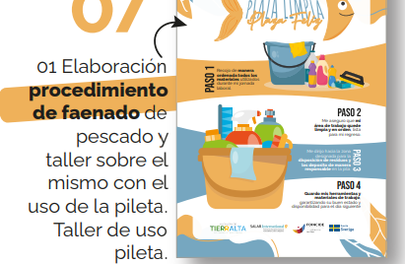
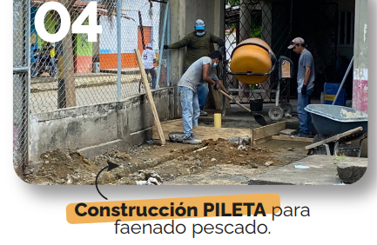
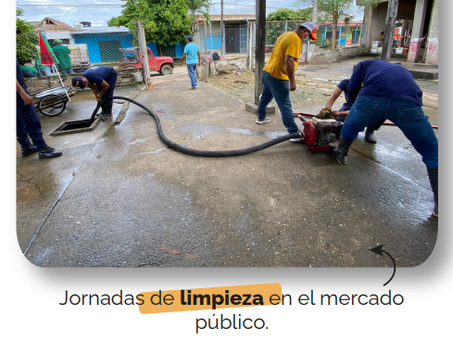
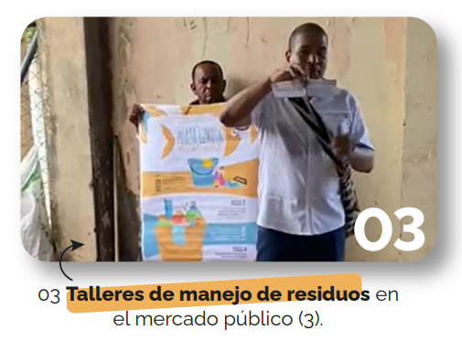
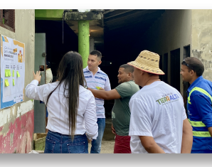

Slide 3
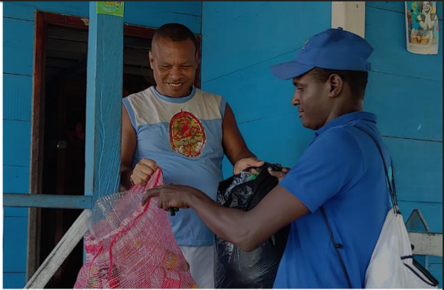
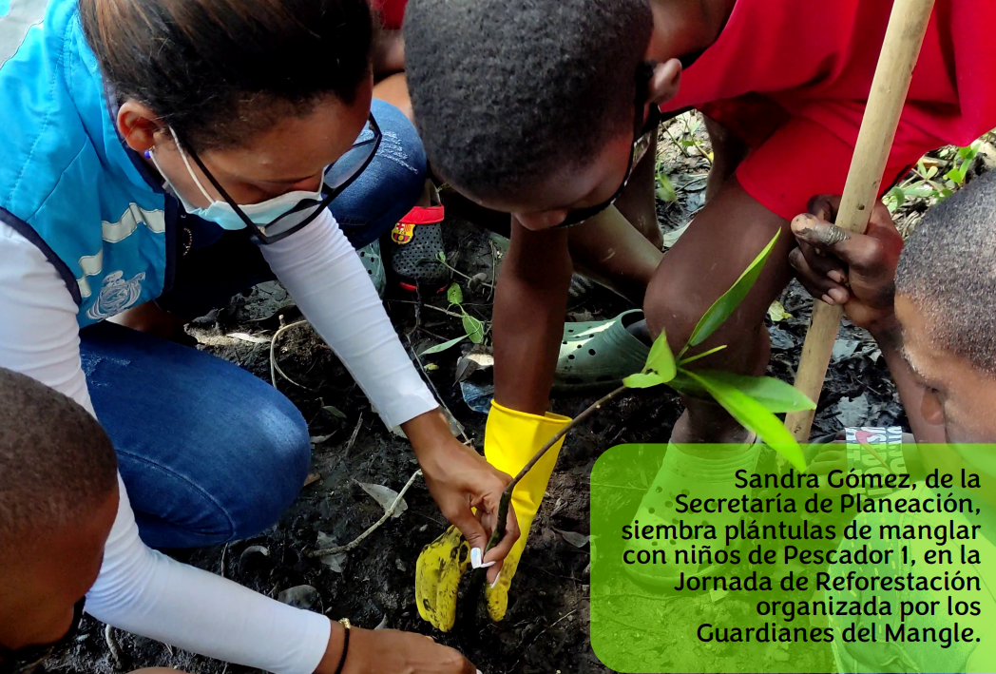
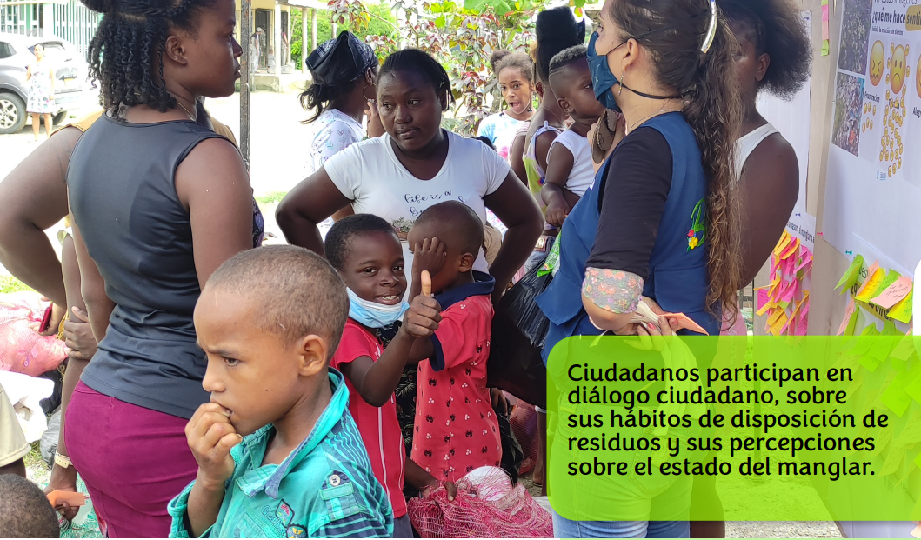
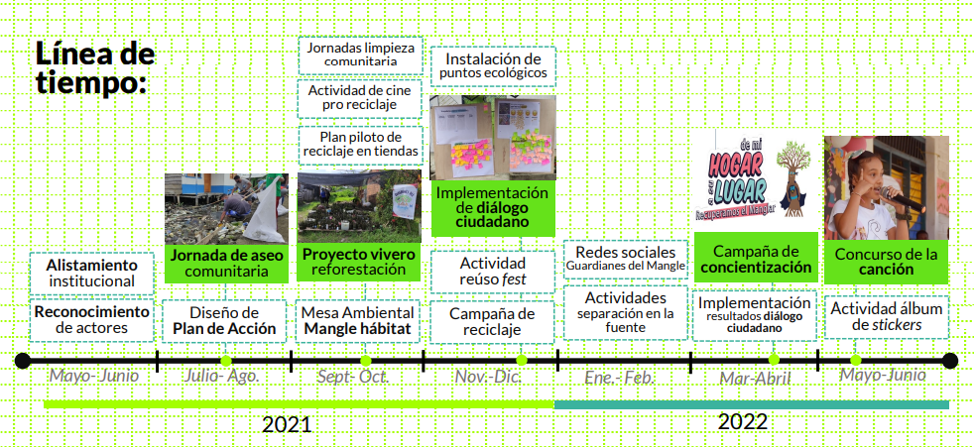

Slide 4
Key lessons learnt from FOINCIDE
First lesson: Start where people are — and build from real needs.
Second lesson: Local governments are entry points to broader ecosystems.
Third lesson: Flexibility is not a luxury — it’s what makes local ownership possible.
Fourth lesson: Test locally — scale strategically.

