Slide 1


EU System
for an Enabling Environment for Civil Society
(EU SEE)
__________________________
EU SEE Introductory Session- 23 April 2025

Slide 2
What is EU SEE?
The EU System for an Enabling Environment for Civil Society (EU SEE) program supports civil society to detect and respond to situations of a deteriorating or improving enabling environment in 86 countries across Africa, Asia, Latin America and the Caribbean, North Africa and the Middle East.
Monitor and Early Warning Mechanism
Flexible Support Mechanism
Led by Oxfam Novib, with Protection international, Urgent Action Fund Latin America and CIVICUS
Led by HIVOS, with CIVICUS, Transparency International, European Partnership for Democracy (EPD),Forus, Democracy Reporting international

Slide 3

Peace and Conflicts
EE for
Civil Society
Free & fair elections
6
Access to a secure digital environment
1
Respect and protection of fundamental freedoms
+
Rule of law
2
Supportive legal and regulatory framework
Social cohesion and equality
5
Supportive public culture and discourses on civil society
Respect of human rights
Political representation
4
Open and responsive State
3
Accessible and sustainable resources
Civic education
Information Space
Enabling principles

Slide 4
EWM
Ongoing
EES
Three times a year
CFR
Once a year
Updated data on events that influence or might influence the enabling environment. Triggers alerts for potential restrictions and opportunities for advancement.
A concise picture of the current state of the EE. Offers a quick overview of recent developments and their implications.
Provide a comprehensive assessment of the EE. Assigns scores that reflect progress or setbacks across various dimensions in each country.

Slide 5
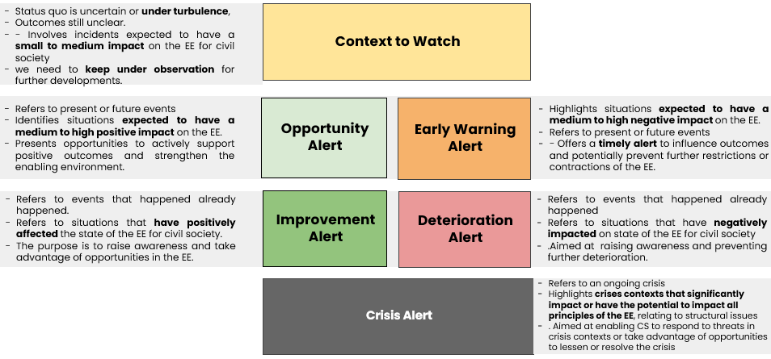
Alert types

Slide 6
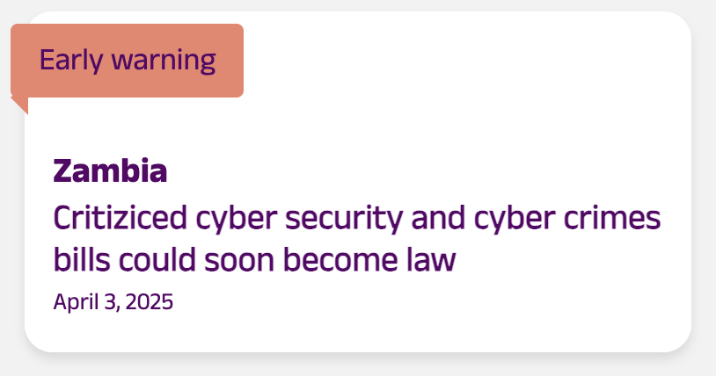
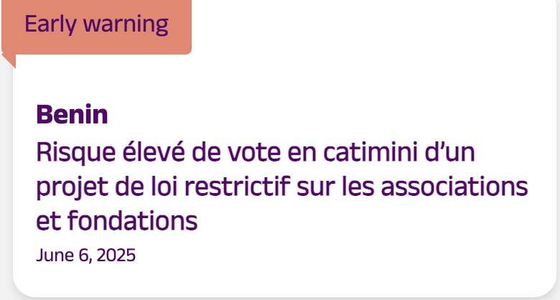
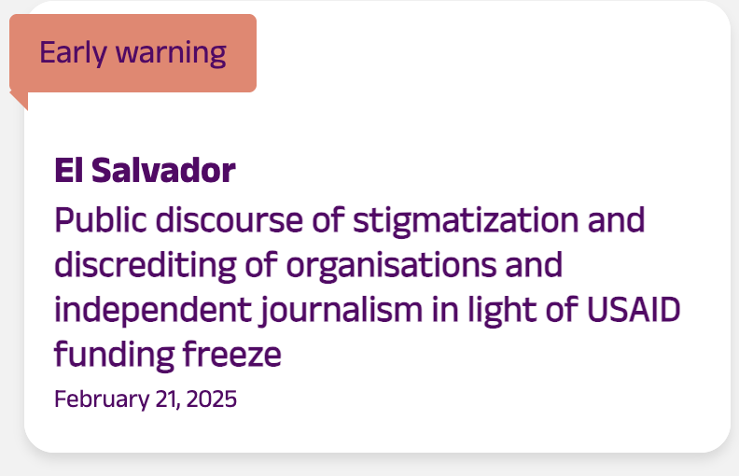
Early Warning Alerts

Slide 7

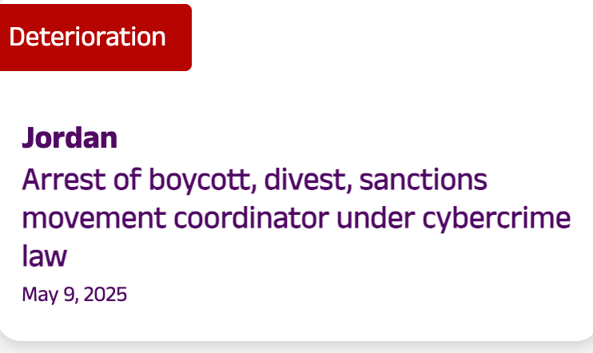
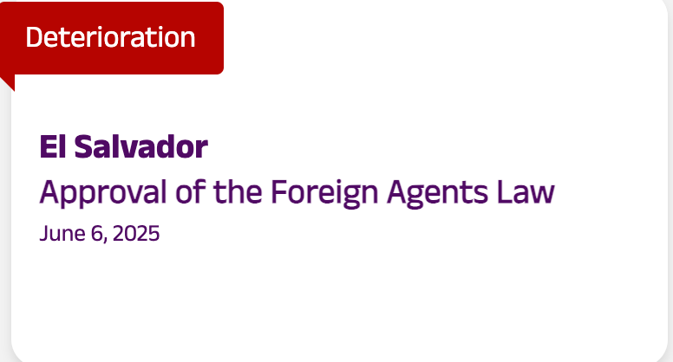
Imrpovement, Deterioration
Alerts

Slide 8

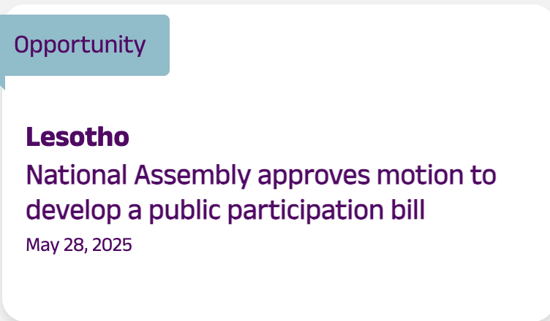
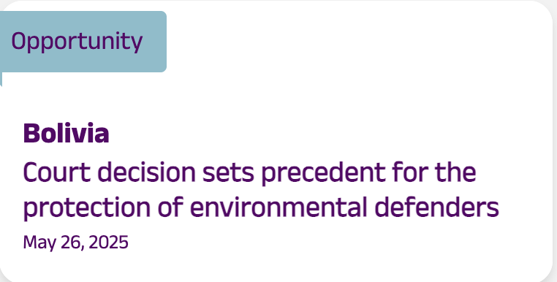
Opportunity Alerts

Slide 9
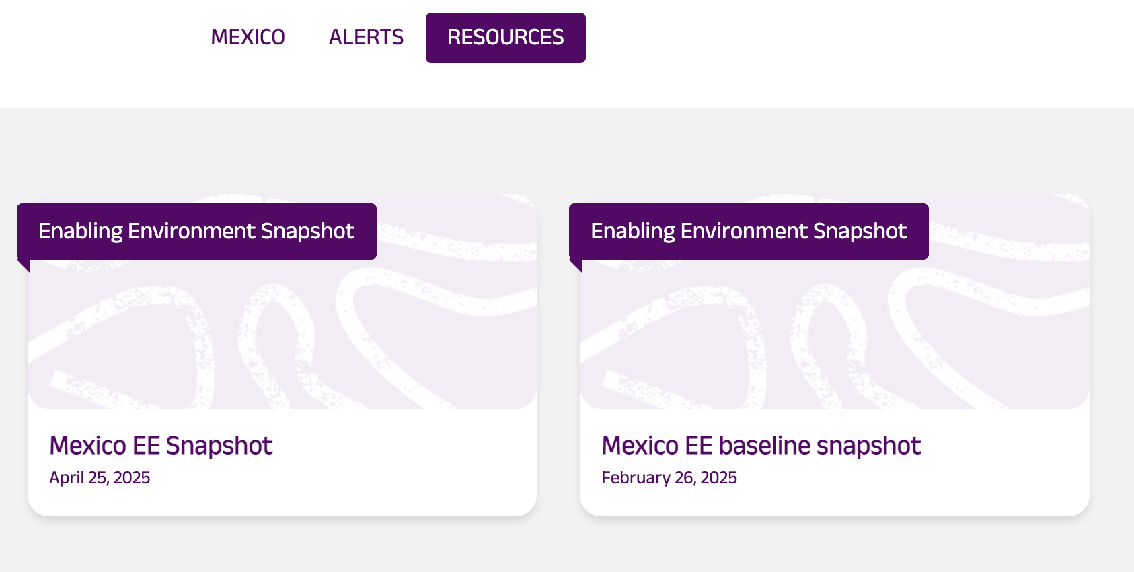
EE Snapshots and CFR

Slide 10


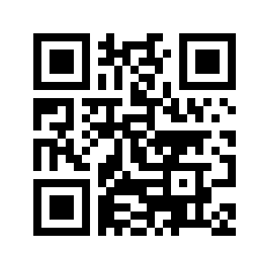
Emerging topics
Email: eusee@hivos.org

